Slide 1

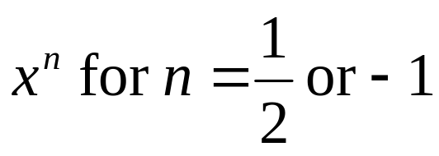
Functions
Find composite functions
Involve f and g which are linear, quadratic, exponential functions or take the form
Domain : refers to x-value
Range : refers to y-value

Slide 2
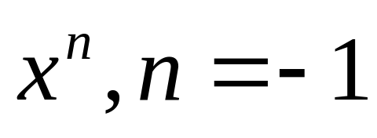
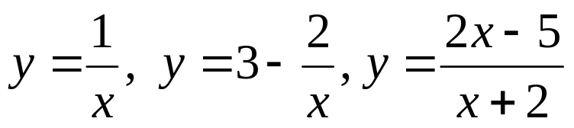
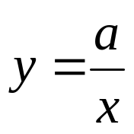
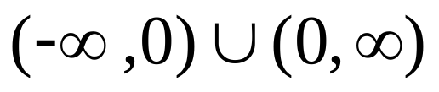

Graphs of
called rectangular hyperbolas (reciprocal functions)
example
The basic graph is
If x = 0, y is undefined. Hence, the domain is
and range is
asymptote is x = 0 and y = 0 (x-axis and y-axis)

Slide 3
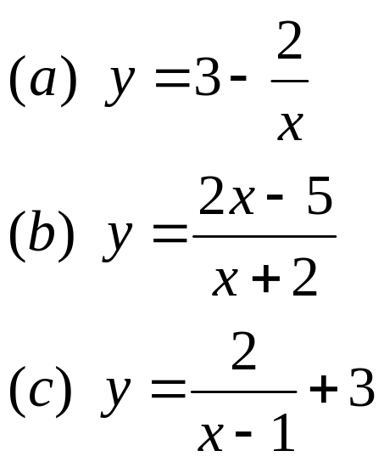
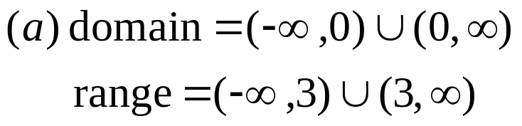
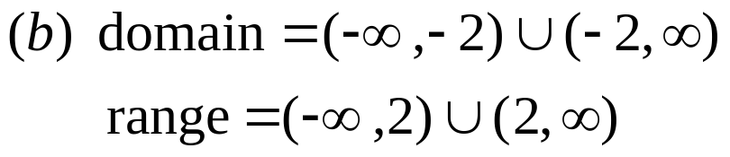
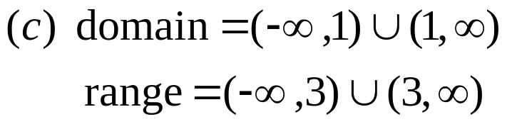
Graphs of
find the domain and range for the following functions:

Slide 4
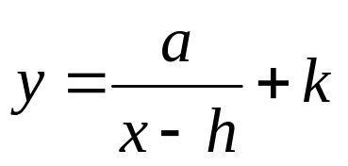
Graphs of
Summary
The graph of is a rectangular hyperbola with the x-axis as horizontal asymptote and y-axis as vertical asymptote
The graph of is the graph of translated h units right and k units upwards

Slide 5
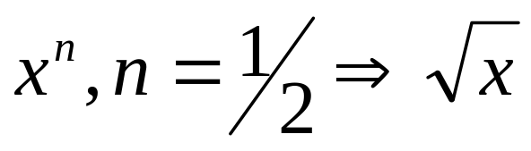
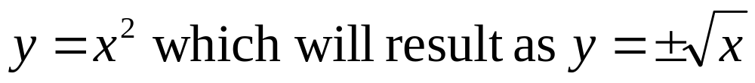
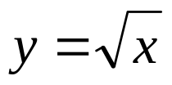
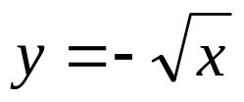


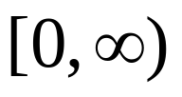
Graphs of
inverse of
The portion of is above the x-axis and below the x-axis is
The domain and range is

Slide 6
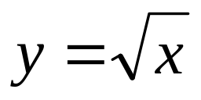
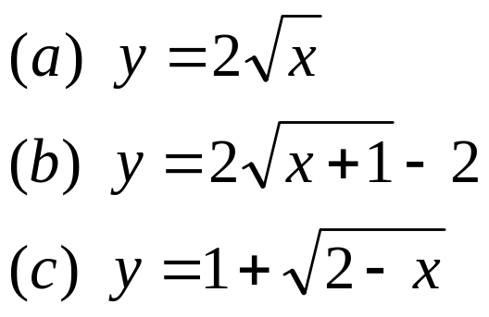
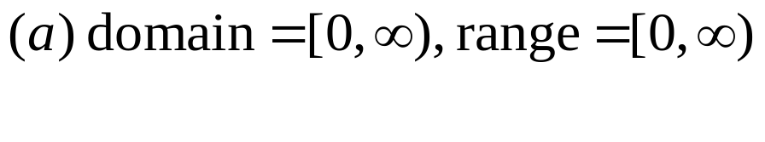
Graphs of
find the domain and range for the following functions:

Slide 7
Composite Function
f
g
x
y
z
Given f :x → y and g : y → z, hence:
The function from x to z (object is x and image is z)
will be gf(x) or g[f(x)] or g o f(x)
Remark: The sequence of writing the composite
function is from the outside to inside

Slide 8
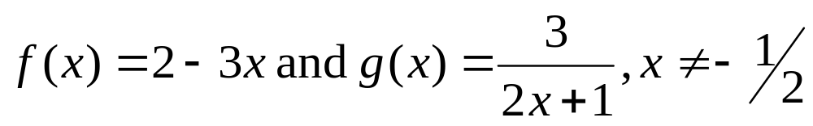
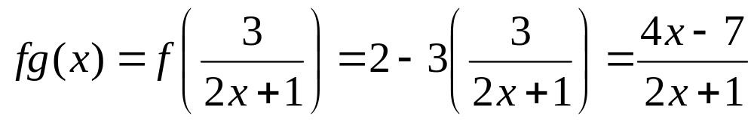
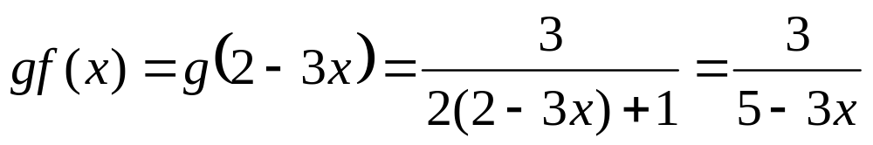
Composite Function
Given the function
Find the composite function of:
(a) fg(x) (b) gf(x)
(c) ff(3)
Solution:
(a)
(b)
(c) ff(x) = 5

Slide 9
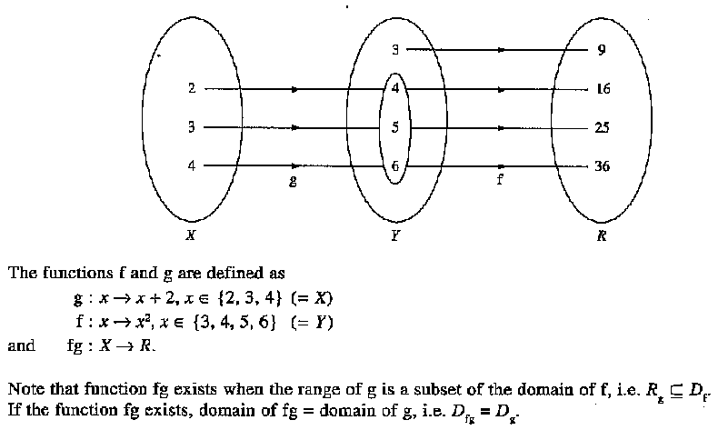

Slide 10
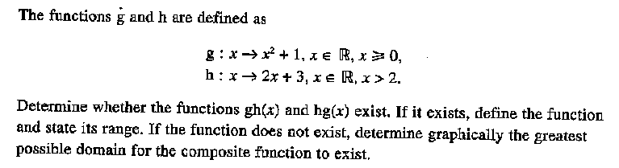
Example

Slide 11
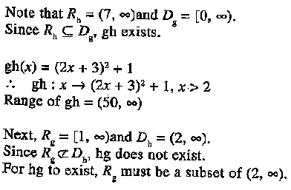
Solution

